Slide 1
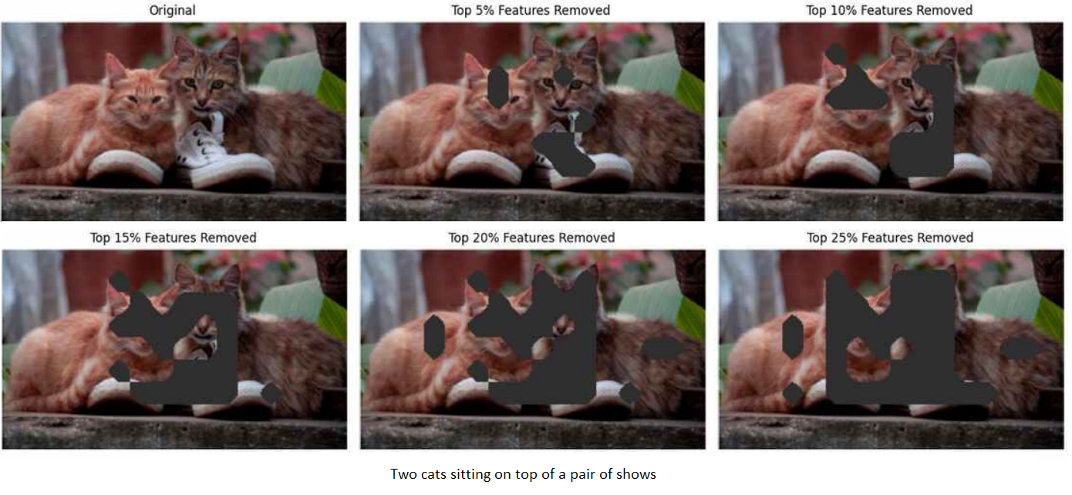
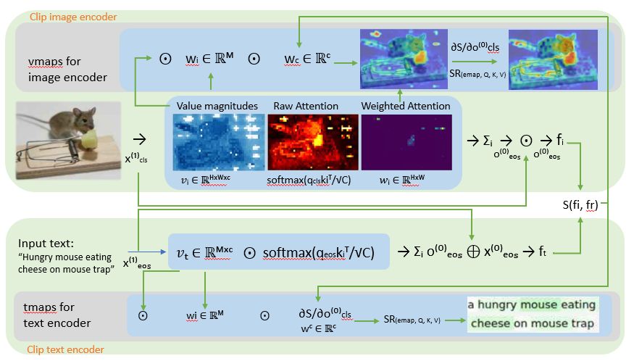
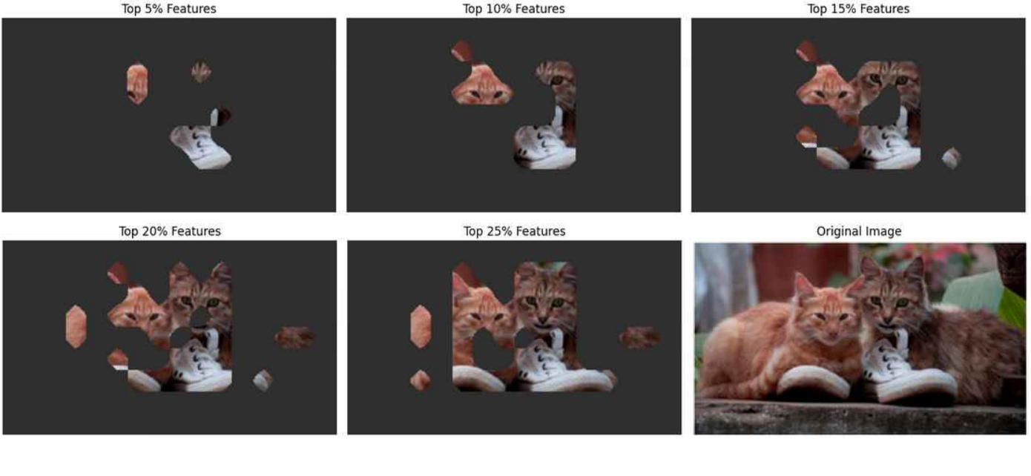
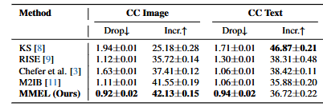
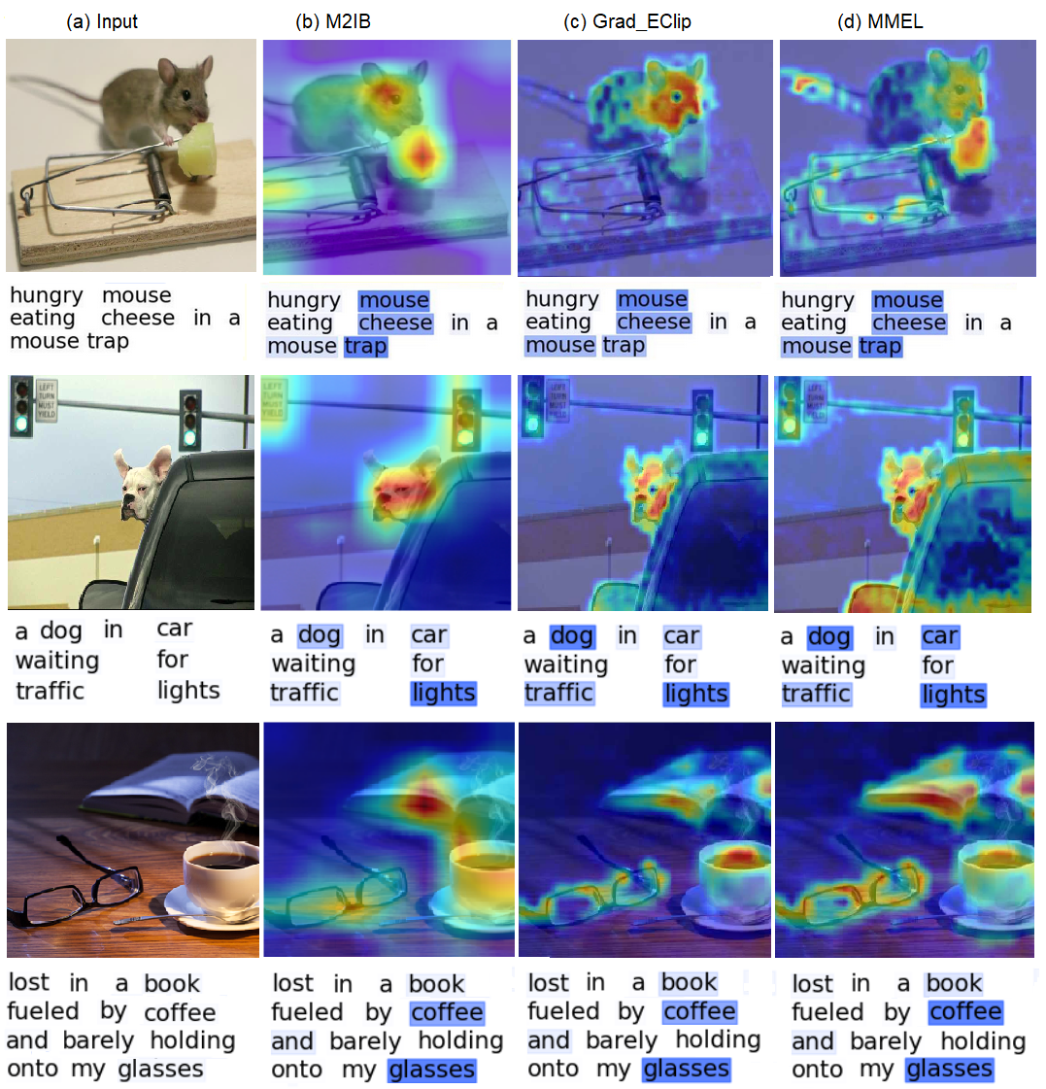
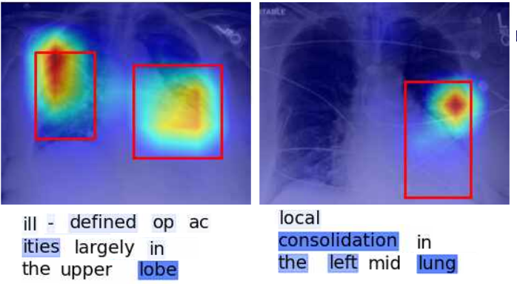
G2SEM: Gradient-Guided Semantic Relationship Analysis for CLIP Interpretability
Muhammad Imran
School of Computing and Engineering, UMKC
Introduction
Methodology
Evaluations
Machine Learning & Interpretability Challenges
ML has advanced vision and language tasks, especially in healthcare.
Black-box models pose risks in safety-critical areas like medical imaging.
Clinicians need both high accuracy and transparent explanations.
Multi-Modal Explainable Learning (MMEL) Framework
Unified Vision-Language Framework: Fuses visual and textual data via a learnable bottleneck to retain critical diagnostic features.
Enhanced Attribution Mechanism: Uses gradient-based strategies for localized and transparent explanations.
Semantic relationship computation on top of gradient descent for localized explanation maps. For both vision and text.
Comprehensive Evaluation: Outperforms existing methods on datasets (Conceptual Captions, MS-COCO, MS-CXR).
High-Stakes Suitability: Experiments confirm MMEL’s superior interpretability and reliability.
Our approach uses gradient descent to get the gradient scores for different regions and then applies semantic relations to get gradient scores of the objects in image: The architecture consists of three main components
Important features of an image are removed gradually and accuracy of the result is evaluated in each step
:CLIP Encoders (Image and Text)
Process input image and text through pretrained CLIP model
Gradient Analysis
Computes similarity b/w image and text features
Compute Query, Key, Value from the model
Compute layer wise cosine similarity using Q,K,V
Applies gradient descent to generate initial attention maps
Semantic Relationship Module (our contribution)
Hierarchical Processing: Analyzes features at multiple scales
Multi-scale Attention: Computes normalized feature similarity
Feature Enhancement: Amplifies important semantic regions
The final enhanced map is calculated as:
SR(emap, Q, K, V) = ((f(emap, α, S(Q, K, V)) - min) / (max - min))²
Important features are added gradually into an empty image and accuracy is evaluated in each step.
Related work
Grad-ECLIP: Uses gradient descent to get to the important features and tokens and heatmaps to draw emaps. Limited interpretability in complex models.
M2IB: Uses Information bottleneck Attribution and then heatmaps to show salient regions and tokens. Struggles with accuracy vs interpretability balance.
RISE: This generates emaps indicating how salient each pixels is by probing the model with randomly masked versions of the input image.
VLPMs: Powerful but lack interpretability.
LVLM-Interpret: Interactive model visualization.
VL-CBMs: Aligns models with expert concepts.
LC-LLM: Explains lane changes in driving.
UniBind: Builds multimodal knowledge bases.
IMAGEBIND: Learns from six modalities.
LanguageBind: Extends models beyond vision-language.
CLIP Surgery: Fixes noisy activations, improves explainability.
Results with baseline
Below is the comparison of our model results with baseline on Conceptual Captions dataset.
Results
Our method demonstrates significant improvements over baseline approaches:
Better multi-object localization in complex scenes
More precise boundary detection for semantic regions
Improved sensitivity to subtle semantic relationships.
Noise reduction using information bottleneck attribution.
This approach can be applied to cancer xray images where it will be able to highlight the cancerous cells.
Conclusion
MMEL enhances interpretability in vision-language models with a learnable bottleneck and gradient-based attribution for transparent explanations. An Enhanced Semantic Relationship module improves feature visualization, aiding model debugging and bias detection.
Acknowledgment
Dr. Yugyung Lee
References
Datasets
Zhao, Y. Li, and H. Wang. Gradient-based visual explanations for transformer-based vision–language models. In Proceedings of the IEEE Conference on Computer Vision and Pattern Recognition (CVPR), pages 1234–1243, 2024
Chenyang Zhao et al. Gradient-based visual explanation for clip. In International Conference on Machine Learning (ICML), 2024
Wang et al. Visual–language joint learning under information bottleneck constraints. In Proceedings of the IEEE Conference on Computer Vision and Pattern Recognition (CVPR), 2023.
Conceptual Captions: Contains image-caption pairs for captioning models
MS COCO: Contains images, object annotations, and captions for vision tasks.

